Slide 1

Accident Detection And Alert System
The A Team

Slide 2
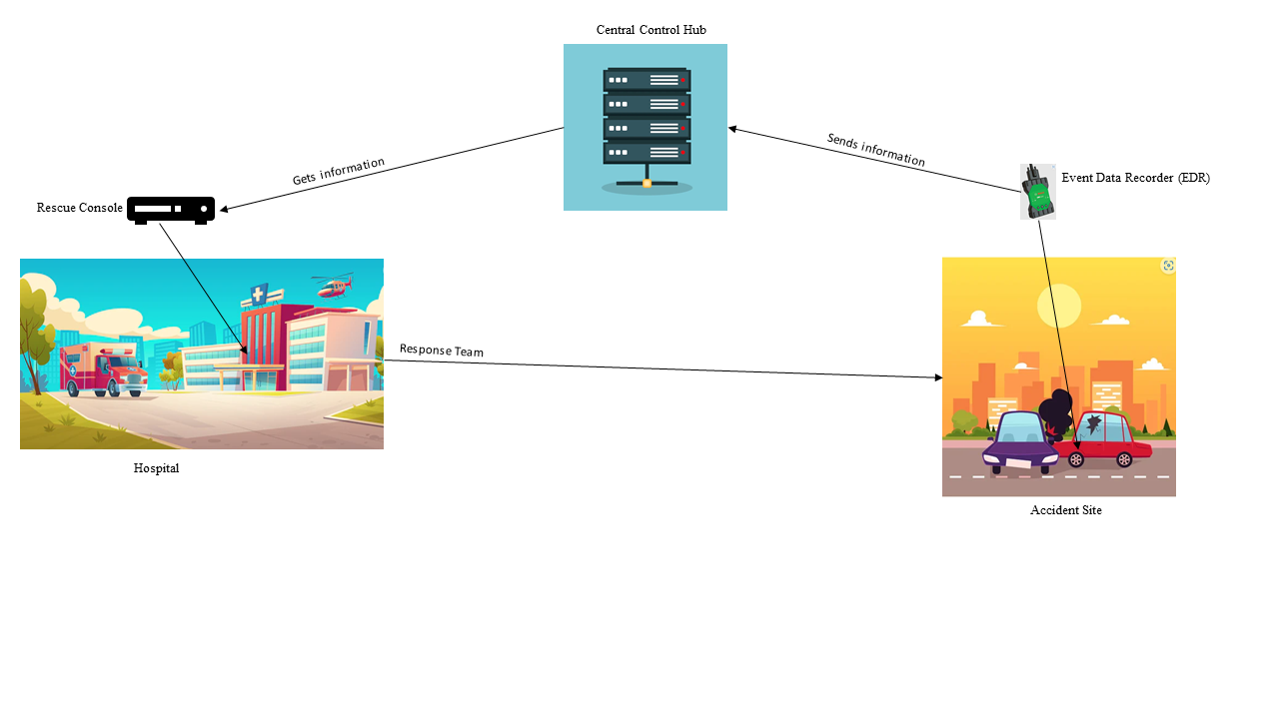
Concept

Slide 3
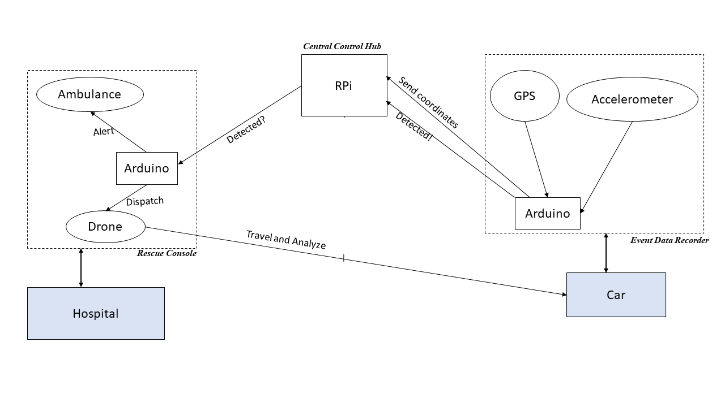
Concept: Block Diagram

Slide 4
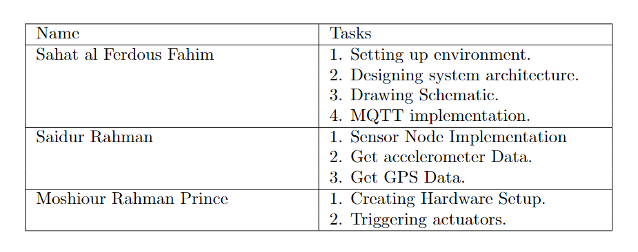
Task responsibility

Slide 5
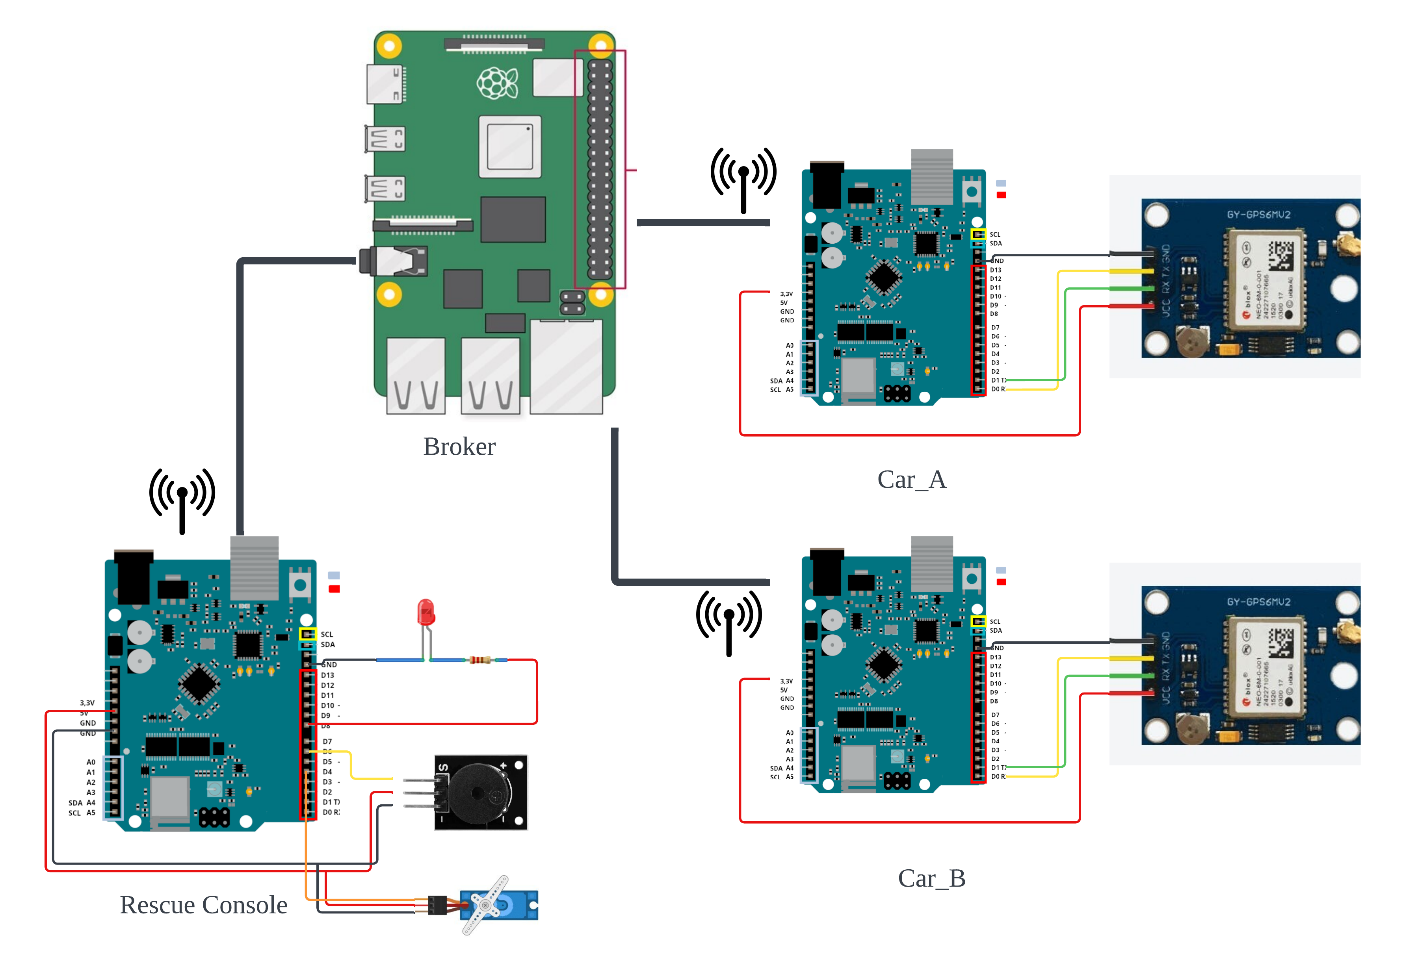
Implementaion

Slide 6
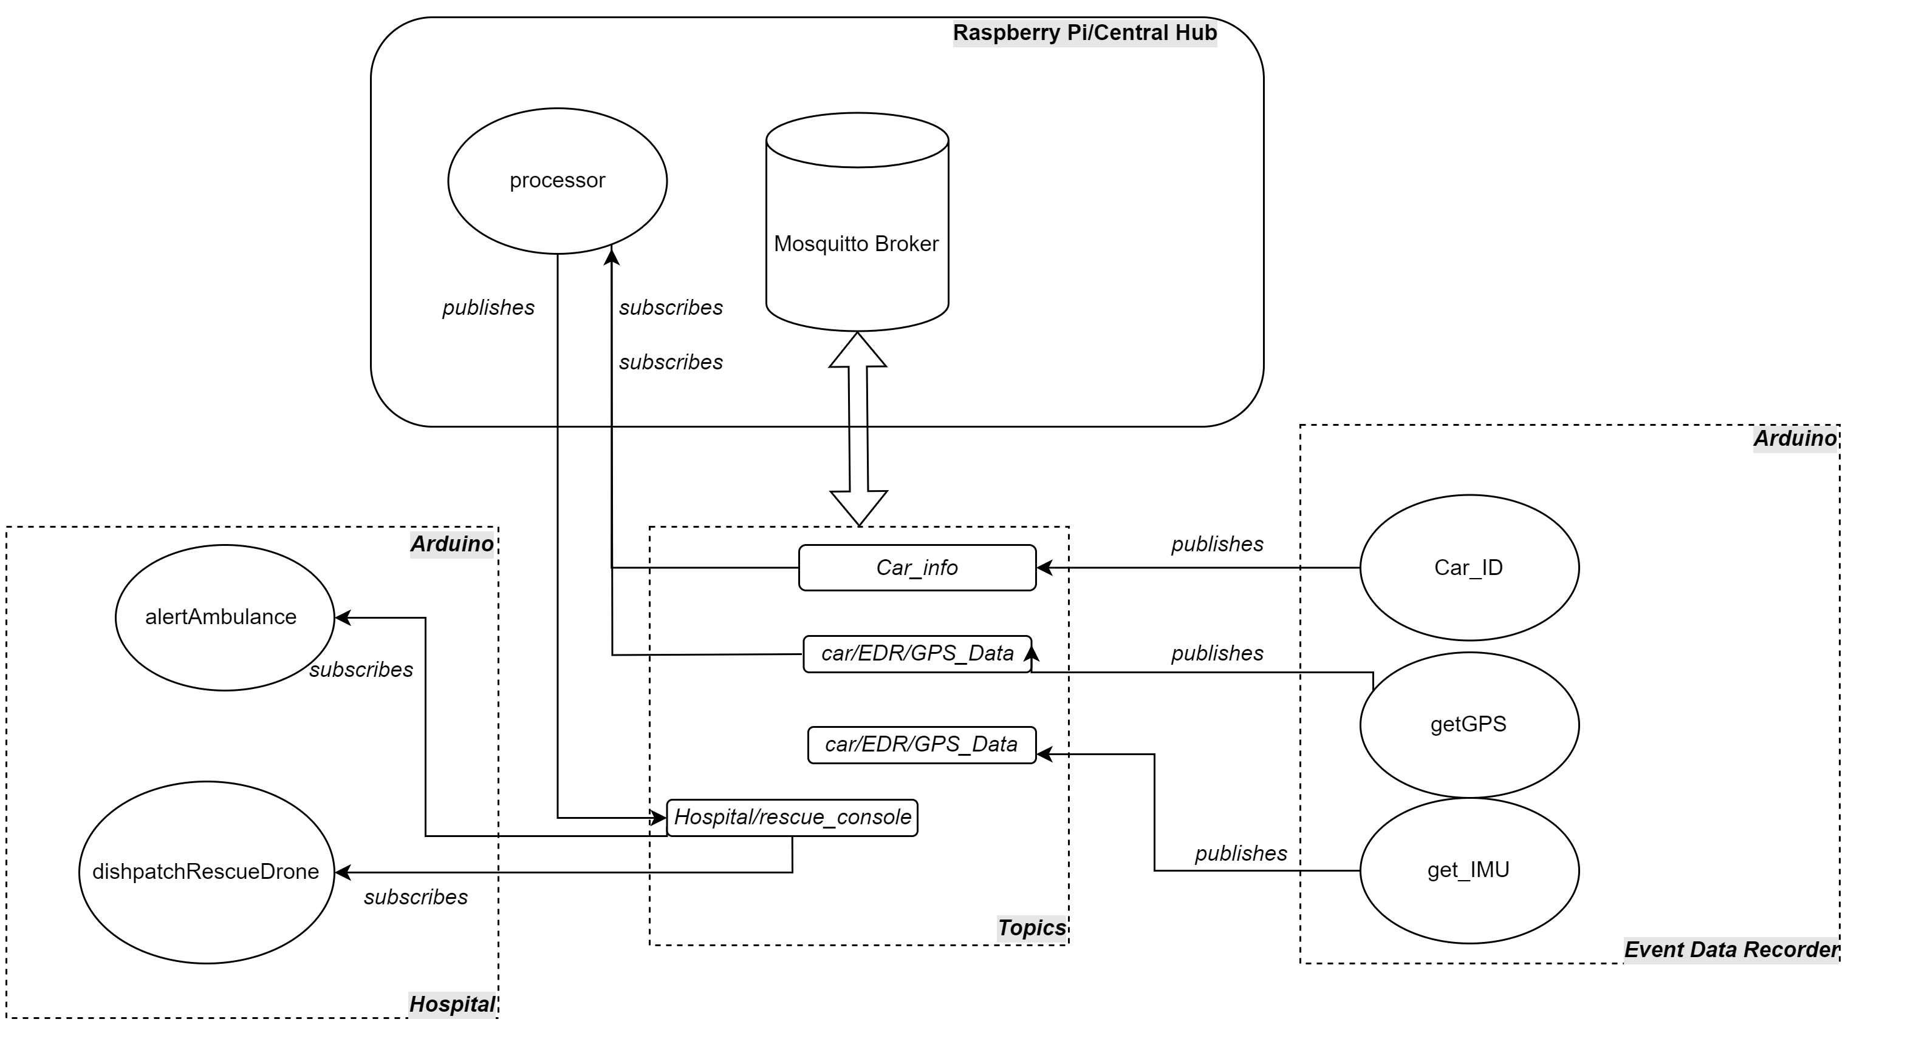
Implementaion

Slide 7
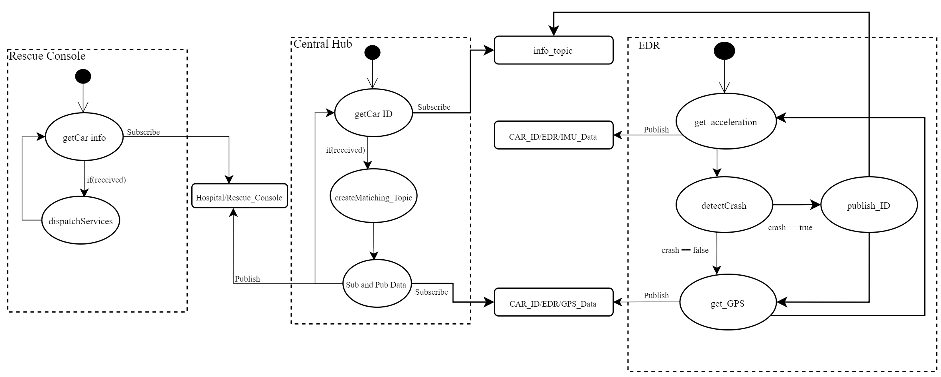
Implementaion

Slide 8
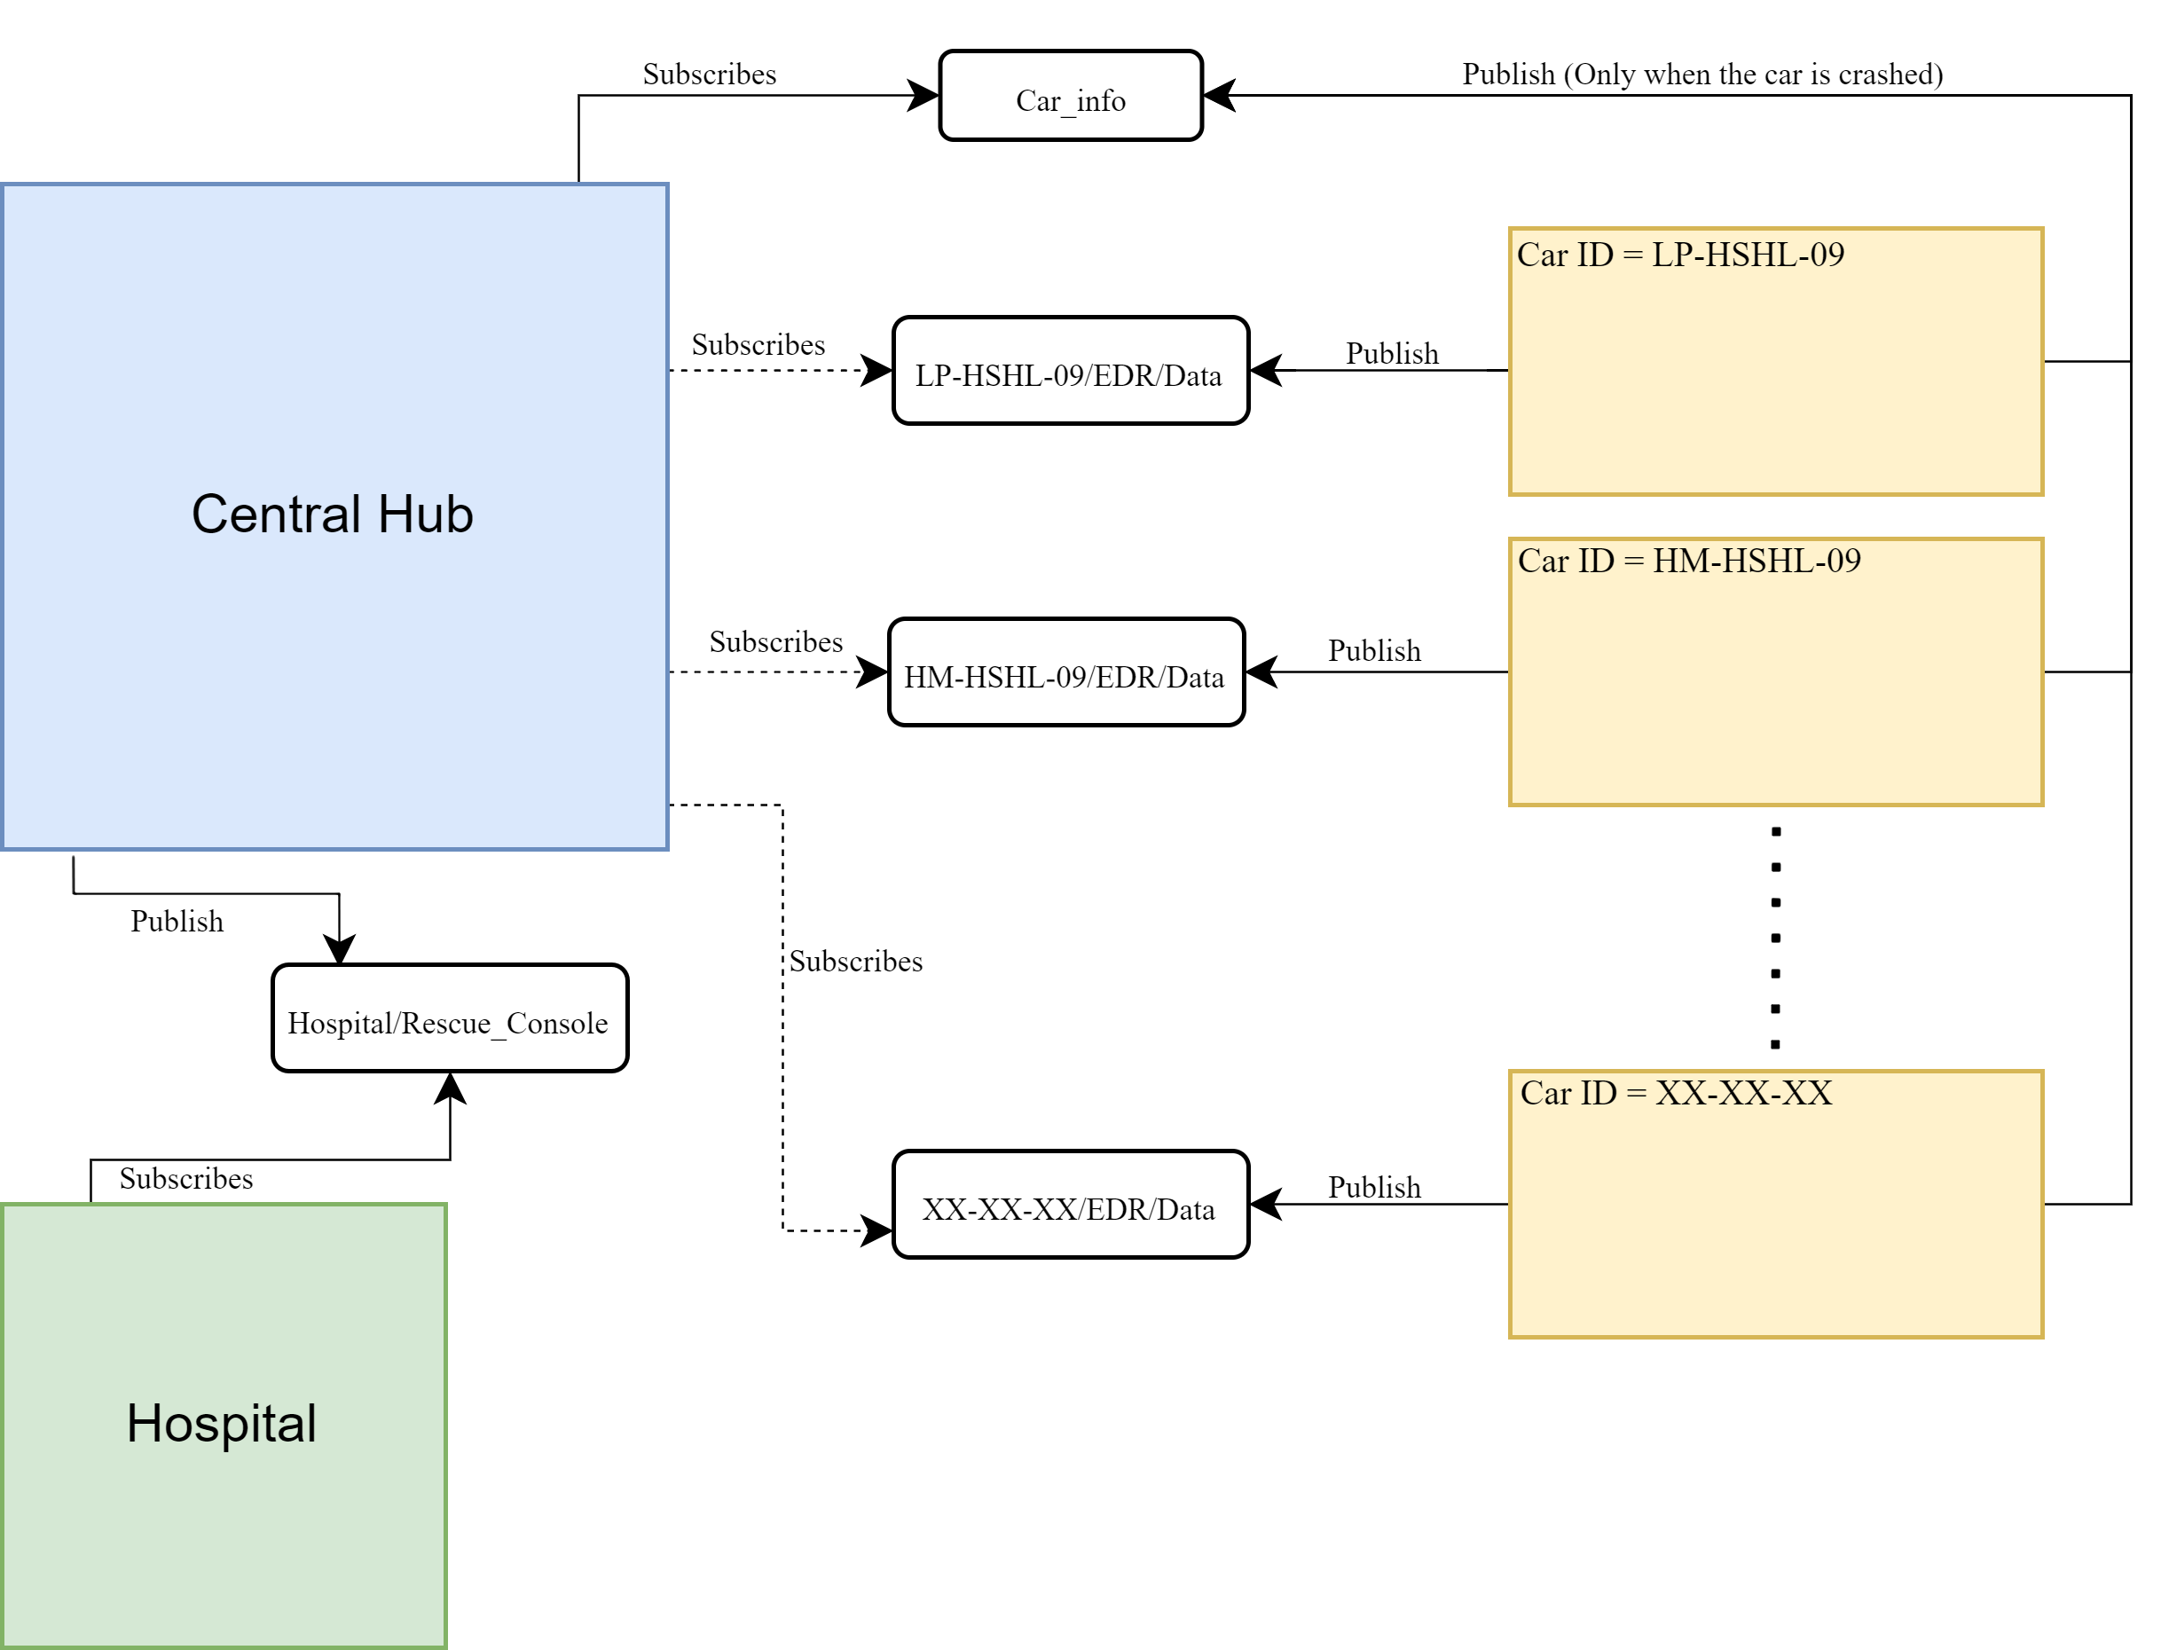
Implementaion

Slide 9
showcase

